Slide 1
KM – Investment Bank

Slide 2

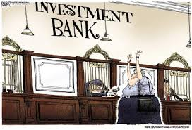
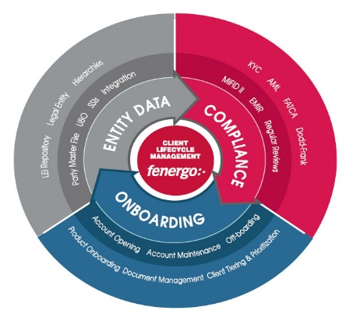
Topics of Discussion
Introduction to the Financial Markets, Assets & Risks
Financial Markets & Assets
Derivative Products
Market Participants
Risks
Investment Bank
Structure
Functions
Primary Market
Secondary Market
Commonly Used Platforms
Trade Life Cycle
Introduction to Trade
Life Cycle of a Trade
Trade Execution, Validation, Enrichment
Reconciliation
Securities Lending
Confirmations
Settlements
Brokerage Life Cycle
OTC Clearing Cycle
eClerx HeatMap

Slide 3
Introduction to Financial Markets, Products & Risks

Slide 4

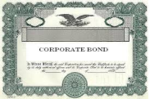

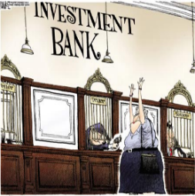




Financial Systems: Overview
Money Market
Foreign Exchange
Commodity Market
Capital Market
Market Participant
RISK
Market Participant
Loans
Market Participant
Bonds
Mutual Funds
Shares
RISK
Regulatory Body
RISK
Market Participant
RISK

Slide 5
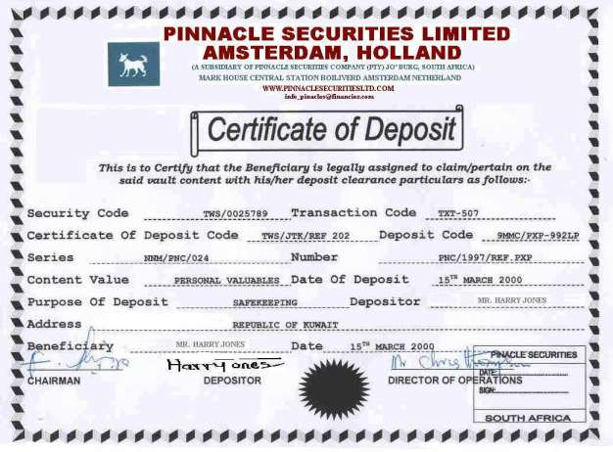
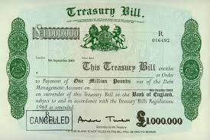

Money Market
Product | Certificate of Deposits | Treasury Bills | Commercial Bills / Trade Bills | Commercial Paper | Call Money / Notice Money
Duration | 30/90/180 days or 1-5 years | 30/90 days or 1 year | 30/60/90 days | 1 to 270 days | 1 to 15 days
Issuer | Banks and Credit Unions | Government | Firms and Banks | Large corporations | Bank

Slide 6
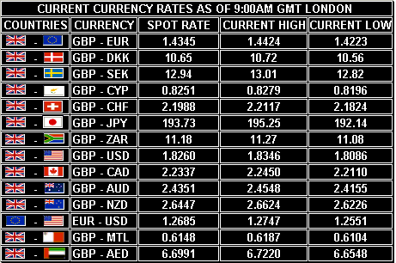
Foreign Exchange (Forex / FX)
OTC market where brokers and dealers negotiate directly with one another
Largest, most liquid market in the world with average trade value ~$1.9 trillion daily
Includes all currencies and is open 24 x 5
Major financial centers are:
London | New York | Tokyo | Zürich | Frankfurt | Hong Kong | Singapore | Paris | Sydney

Slide 7

Commodities Markets
Companies offset their risk of purchasing or selling natural resources for future use
Prices of things like oil, corn and gold are volatile, companies can lock in a price today
Investors only speculate in commodities, with no intention of purchasing large quantities
Major financial Exchange are:
CBOT / CME / Dubai Mercantile exchange / LME / Kansas city board of trade
Notes:
CBOT: Chicago board of trade
CME: Chicago mercantile exchange
LME: London Metal exchange

Slide 8
Capital Markets
Capital markets deal in medium and long term funds for both debt and equity
Institutional arrangement for borrowing funds for medium and long term
Provides facilities for marketing and trading of securities
Capital Market
Long term
Governed by SEBI
Primary Market
Secondary Market
New Securities Issued
Trade in issued securities

Slide 9
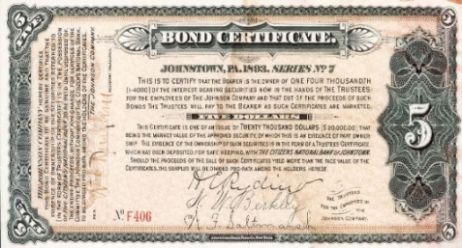

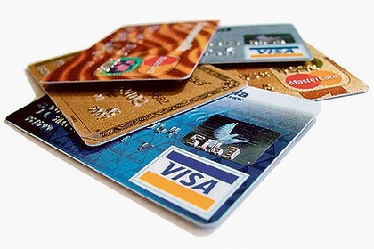
Financial Assets
Financial assets include cash and cash equivalents
Contractual right to receive cash
Other financial assets from another entity, and securities issued by another entity
Examples of Financial Assets
Bonds:
Debt investment where investor lends money to an entity (corporate or government)
Investment for a defined period at a variable or fixed interest rate
Loans:
Loan is a debt provided by one entity to another entity at an interest rate
Types of Loans:
Open-ended loans are loans that you can borrow over and over, eg credit cards
Closed-ended loans cannot be borrowed once they’ve been repaid; eg. auto loans
Secured and Unsecured Loans:
Secured loans are loans that rely on an asset as collateral for the loan
Unsecured loans don’t have asset for collateral; generally have higher interest rates

Slide 10
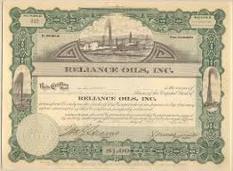


Financial Assets
Shares:
Shares form a unit of ownership of a company and is offered for sale to raise capital
Two main types of shares are common shares and preferred shares
Mutual Funds:
Investment vehicle, made up of a pool of funds from investors for investing in securities
Structured portfolio to meet investment objectives; operated by money managers
Video link for Financial Assets

Slide 11
Derivatives – Exchange Traded vs. OTC
Derivatives:
Instruments whose price is dependent on or derived from one or more underlying assets
Contract between parties; value determined by price fluctuations of underlying asset
Enables trade in price fluctuations of underlying without trading directly in that asset
Exchange Traded derivative is listed and traded on an organized derivatives exchange
OTC Derivatives can be tailored and customized to suit exact risk and return needs
Parameters | Exchange Traded | Over The Counter
Contract Type | Standard (Underlying Amount | Settlement Date) | Bespoke / Customized
Clearing | Centrally Cleared | Bi-Lateral / Centrally Cleared
Order Type | Automated | Phone Based (Usually)
Operating Hours | Exchange Hours | 24*7
Framework | Set Rules & Procedures | Flexible
Risk | Low | Medium / High
Products | Limited Products (Futures | Options) | Product Proliferation / Dynamic (Baskets | Swaps | Warrants | Forwards)

Slide 12
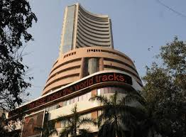

Derivatives – Exchange Traded vs. OTC
Parameters | Exchange Traded | Over The Counter
Products Contd. | Futures: Agreement between two parties to buy or sell an asset at a certain time in the future at a certain price | Baskets: Portfolios of underlying assets; usually a moving average or a basket of assets
 | Options: Underlying is an exchange | Options: Underlying can be baskets or individual assets
 |  | Warrants: Longer-dated options are called warrants
 |  | Forwards: A customized contract between two parties to buy or sell an asset at a specified price on a future date
 |  | Swaps: Swaps are private agreements between two parties to exchange cash flows in the future according to a prearranged formula. They can be regarded as portfolios of forward contracts. Swaps are of 2 types: Credit Default Swap Interest Rate Swap

Slide 13
Derivatives – Option
Writer: Seller of an option who collects premium payment from holder
Holder: Party who buys an option
Option Premium: Income received by an investor who sells or ‘writes’ an option
Strike Price: Price at which a specific derivative contract can be exercised
Spot Price: Price at which a security can be bought or sold at a specified time and place
Writer
Holder
Obligation
Option Premium

Slide 14
Derivatives – Options
ABC stock is currently trading at $110 per share
Investor purchases one call option contract on ABC with a $100 strike and at a Premium of $12.00 per Share
The actual cost of this option will be $1200 (100 shares x $12.00 = $1200)
Price
Breakeven
“in the money”
(Exercise the option)
$110
$100
Strike
“at the money”
$80
“out of the money”
(Do not exercise the option)
Time

Slide 15

Derivatives – Credit Default Swap
A credit default swap is a contract in which one party (protection buyer) pays a periodic fee to another party (protection seller) in return for compensation on default (or similar credit event) of reference obligation by reference entity (not a party to the credit default swap)
Default
Protection seller
(Y)
Pays Fixed Period Premium
Default
Protection buyer
(X)
Payback Amount
Buys Bond (Reference Obligation)
Coupon Payment
Bond
Loans
$$$
Credit event
Reference
Entity
Reference
Obligation

Slide 16
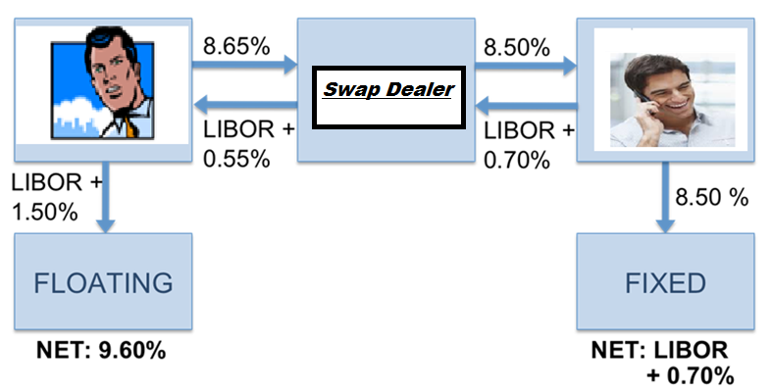
Derivatives – Interest Rates Swap
A swap is an agreement to exchange one set of cash flows for another
Commonly used to:
Switch financing from one currency to another
Replace floating interest with fixed interest
Swap Dealer: An individual who acts as the counterparty in a swap agreement for a fee called a spread

Slide 17



Market Participants – Banks
Exchanges:
Organized and regulated financial market where securities (bonds, notes, shares) are bought and sold at prices governed by forces of demand and supply
Stock exchanges basically serve as:
Primary markets where companies can raise capital
Secondary markets where investors can sell their securities to other investors
Stock exchanges impose stringent rules, listing requirements and statutory requirements
What is a bank?
A business establishment in which money is kept for saving or commercial purposes or is invested, supplied for loans, or exchanged
Types of Banks:
Central Banks
Commercial Banks
Private Banks
Investment Banks
Video link for Stock Exchange

Slide 18






Market Participants – Central Banks
A national bank that provides financial and banking services for its country's government and commercial banking system, as well as implementing the government's monetary policy and issuing currency. Central banks also usually oversee the commercial banking system of their respective countries.
Primary Function of Central Bank may include:
Implement monetary policies and determine Interest rates
Control nation's money supply; usually also prints the national currency
Government's banker and the bankers' bank (“lender of Last Resort")
Manage country's Foreign Exchange and gold reserves and Government's stock register
Regulate and supervise banking industry
Video link for Central Bank

Slide 19



Market Participants – Commercial Banks
A financial institution that provides services, such as:
Accepting deposits and basic investment products like savings accounts and certificates of deposit
Giving business loans and auto loans, mortgage lending
Corporations or large businesses, as opposed to individual members of the public (retail banking)
Some commercial banks, such as Citibank and JPMorgan Chase, also have investment banking divisions, while others, such as Ally, operate strictly on the commercial side of the business
Primary Function of Commercial Bank may include:
Collects and clear cheque, dividends and interest warrant
Make payments of rent, insurance premium, etc.
Deal in foreign exchange transactions
Purchase and sell securities
Act as trustee, attorney, correspondent and executor

Slide 20



Market Participants – Private Banks
Private banking is banking, investment and other financial services provided by banks to private individuals who enjoy high levels of income or invest sizable assets.
The term "private" refers to customer service rendered on a more personal basis than in mass-market retail banking, usually via dedicated bank advisers. It does not refer to a private bank, which is a non-incorporated banking institution.
Primary Function of Private Bank may include:
Portfolio management
Provide high level of services to the HNI clients
Manage Multi Currency Accounts and exclusive investment-related advice
Manage investments to address a client's entire financial situation
Plan retirement and passing wealth on to future generations
To act as trustee, attorney, correspondent and executor
Video link for Private Bank

Slide 21



Market Participants – Investment Banks
An investment bank is a financial institution that assists individuals, corporations, and governments in raising financial capital by underwriting or acting as the client's agent in the issuance of securities (or both).
An investment bank may also assist companies involved in mergers and acquisitions (M&A) and provide ancillary services such as market making, trading of derivatives and equity securities, and FICC services (fixed income instruments, currencies, and commodities).
Primary Function of Investment Bank may include:
Handles corporate, Large firms, HNI Clients, Governments etc.
IPOs, Public and Private share offering
Provides expertise in terms of M&A
Risk management & Underwriting
Market making
Video link for Investment Bank

Slide 22
Market Participants – Difference between Banks
Difference between Investment Bank and Commercial / Retail Bank
No. | Investment Bank | Commercial / Retail Bank
1 | Handles corporate, Large firms, HNI Clients, Governments etc. | Handles common people
2 | Does not take deposits or provide loans | Takes deposit from individuals and lends to its customers
3 | Provides expertise in terms of M&A | Does not have expertise to provide the same
4 | Deals with complex financial products like derivatives, etc. | Does not deal with complex financial products
5 | Earns on a transaction-basis rather than an interest spread | Earn on differential interest rate received borrowers and paid to depositors
6 | Provide ancillary services | Provide standardized services

Slide 23
Market Participants – Difference between Banks
Difference between Central Bank and Commercial / Retail Bank
No. | Central Bank | Commercial Bank
1 | Apex monetary institution, empowered to exercise control over country’s banking system | Commercial bank is a constituent unit of the banking system
2 | Does not operate with a profit motive | Profit earning is the primary objective
3 | Generally a state-owned institution | Generally a privately owned institutions
4 | Does not deal directly with public | Deals directly with the general public
5 | Monopoly of note-issue | Does not enjoy such right
6 | Custodian of foreign exchange reserves | Dealers “not custodians” of foreign exchange

Slide 24
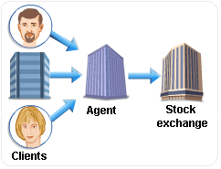
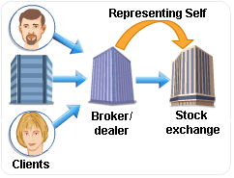
Market Participants –Agents & Broker / Dealer
Agents:
Act as brokers / intermediaries to buy and sell securities on behalf of clients
Charge variable commission for executing a client order
Provide custodial services to clients for a fee
Broker / Dealer:
Operates in dual capacity in the securities marketplace
Act as broker (agent) advising and representing clients in the market
Provide investment advice and facilitate trading activities
Publish investment research and raise capital for companies
Size of the firms can be small independent boutiques or large subsidiaries of big investment banks

Slide 25
Market Participants – Custodians
Custodians:
A specialized financial institution responsible for safeguarding a firm’s or individual’s financial assets
Act as an agency or intermediary, in relation to buying and selling securities on behalf of its clients
Clients can be individuals, institutions, or a combination of both
To Process a Trade:
Seller sends an electronic instruction to custodian to transfer securities from it’s a/c to the buyer’s a/c
Buyer instructs custodian to pay seller cash from its account on receipt of settlement instructions
Custodians try to match the trade. If matched, securities and cash are exchanged on relevant value date.
Custodians will then record changes in relevant securities and cash accounts
Types of Custodians:
Term | Coverage | Example
Custodian | National / International | Deustche Bank, Domestic Custody Services
Global Custodian | Global | State Street, Citigroup, Bank of NY,BNP Paribas
Local Custodian | Local | Credit Lyonnais Paris , Banco Espirito Santo Lisboa
Sub Custodian | National / International | Citibank Milan, Citibank Madrid
Video link for Custodian

Slide 26
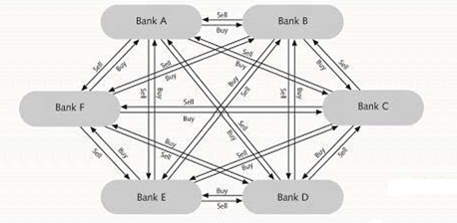
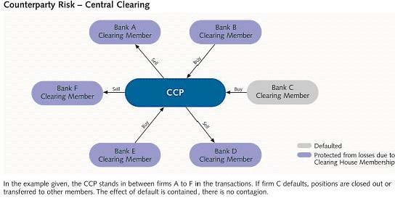
Market Participants – Clearing House
Clearing House:
Clearing function is performed for both OTC and listed trades
Agency responsible for settle trading accounts, clear trades, collect and maintain margin monies
Regulated and well-capitalized entity that settles transactions and ensures delivery of payment
Central clearing was created to remove credit / counterparty risk
OTC market participants trade directly with one another leaving them open to the possibility of default
Clearing services can be performed by a number of entities, such as:
Central clearing counterparties (CCPs),Central securities depositories (CSDs),Clearing members (banks and brokers)
Notes:
Trading without CCP
1.All parties can trade with every other party
2.Terms vary depending on bilateral agreement
3.Dealer defaults borne by direct counterparties
4.Notionals are double-counted (For offsetting trades)
5.Regulators have limited view of true exposure
6.Limited pricing data available
Trading with CCP
1. Clearinghouse is the counterparty to every trade
2. Dealers negotiate bilaterally but clear centrally
3. Terms are standardized
4. Members report prices regularly
5.Members post margin on individual trades
6.Dealer defaults borne by all members
7.Notional netted automatically

Slide 27





Market Participants – Regulators
Regulators
Regulators ensures protection of investors and that maintains fair, orderly, and efficient markets
The work of regulators includes:
Assess the suitability of various market participants to carry out their business
Promote the disclosure of important market-related information
Monitor the business undertaken by banks and other market participants
Monitor transactions for evidence of insider trading, fraud, or other malpractice
Enforcement of legislation and industry practices
Subject financial institutions to certain requirements, restrictions and guidelines to:
Maintain market confidence and integrity of financial system
Protect consumers
Reduce financial crime

Slide 28
Market Participants – Depository
A financial institution or organization that accepts deposits and holds securities and other financial assets
Has legal ownership over these assets and is responsible for controlling those assets
Types of Depositories:
 | Term | Description | Coverage | Example
Depository | Central Securities Depository (CSD) | A specialist financial institution which holds securities in easily transferable book entry form instead of transfer of physical certificates | National / International | DTC (USA) CREST (UK)
 | National Central Securities Depository (NCSD) | Type of CSD which: Handles domestic securities of the country in which it is located | National | NSDL (India) CCASS (HK)
 | International Central Securities Depository (ICSD) | Type of CSD which: Handles domestic and international securities Only 2 organizations are recognized as ICSDs | National / International | Euroclear (Brussels) Clearstream (Luxembourg)

Slide 29
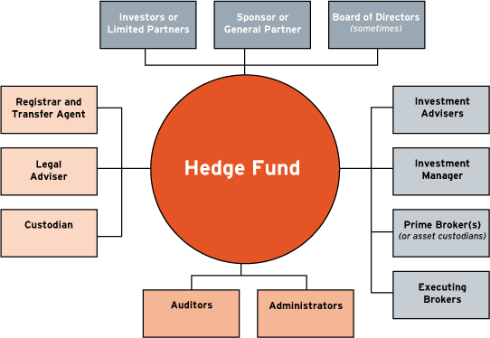
Market Participants – Hedge Fund
A hedge fund is an investment type that uses a wide range of strategies designed to protect investors from downturns in the market while still participating in positive market environments.
Advantages of Hedge Funds
HF strategies have ability to generate positive returns in both rising / falling equity & bond markets
Inclusion of HF in a balanced portfolio reduces overall portfolio risk, volatility and increases returns
Academic research proves HF have higher returns and lower overall risk than traditional investment funds
Ideal long-term investment solution, eliminates the need to correctly time the entry and exit from markets
Utilize a variety of financial instruments to reduce risk, enhance returns
Flexible investment options (use short selling, leverage, derivatives such as puts, calls, options, futures)
Key objective is consistency of returns and capital preservation rather than magnitude of returns
Pension funds, endowments, insurance companies, and high net worth individuals invest in hedge funds

Slide 30
Risk – Key Concepts
Definition
Risk is the potential of loss or failure on account of an action
In financial management, risk relates to any potential material / economic loss attached to the project or trade
Types of Risks
Types of Risk
Systematic Risk
Un-Systematic Risk
Interest Rate Risk
Inflation Risk
Operational Risk
Credit Risk
People Risk
Technology Risk
Judgment Risk
Execution Risk

Slide 31
Basic Classification of Risk
Systematic Risk
The risk which is inherent to the entire market and not a particular stock or industry
It is also known as “Un-diversifiable Risk” or “Market Risk”
The types of systematic risk are:
Interest Rate Risk is the risk that arises for bond owners from fluctuating interest rates
Inflationary Risk
Chance that the cash flows from an investment won't be worth as much in the future because inflation
It is also called purchasing power risk
Unsystematic Risk
Is the type of uncertainty that comes with the company or industry one invests in
Unsystematic risk is due to the influence of internal factors prevailing within an organization
The types of unsystematic risk are:
Credit Risk refers to the risk that a borrower will default on any type of debt by failing to make required payments
Operational Risk are risks resulting from breakdowns in internal procedures, people and systems

Slide 32


Operational Risk
People risk (Decision Making – Managerial / Execution – TAASA)
Decision Making / Judgment Risk arises due to the probability of loss resulting from inaccurate assessment of a situation e.g.
Lack understanding of the procedures to be built
Poor governance structure
Execution Risk risks arising due to not following the agreed upon guideline or procedures
Email Mis-Direct
Erroneously the information not belonging to the actual recipient is shared / sent to them
Operations Error
Issues due to Human negligence
Technology Risk is any risk arising due to Information Technology failures.
E.g. include
VDI Failures
Excel macro Failure
Tool Failure
Video link for Operational Risk

Slide 33
Investment Bank

Slide 34
Investment Bank – Structure
Shared
2. Wealth
Front Office
1.Data Management Services
Client Interaction
Middle Office
4. Financial Control
Back Office
Risk Management
Transaction P&L
3. Product control
Services
6. Legal Doc
Operations
5.Taxation

Slide 35



Investment Bank – Front Office
The front office generates the bank’s revenue and consists of two primary divisions:
Sales
Trading
In broad category, the front office is responsible for:
Initiating and executing transactions
Funding operations
Investments
Front office acts as the interface between the bank and the market, including both clients and other banks
One of the most important role is to put in place and execute trades and transfers between banks
Video link for Investment Bank

Slide 36



Investment Bank – Middle Office
Middle office reports to the treasurer, the chief financial officer, or the head of risk
Focus of middle office is control, valuation, and reconciliation of operations of the front and back office
The middle office evaluates performance, validates models, generates risk reports, and monitors limits
Responsibilities include:
Controls & Valuations
Reconciliation of trades
Performance evaluations
Monitoring risk
Monitoring limits
Typically includes risk management, financial control, corporate treasury, corporate strategy, and compliance
Compliance with internal policies, risk controls, laws, regulations, and supervisory guidelines
Reliability and timeliness of financial and management information
Continuity and reliability of management and financial information systems
Accuracy of accounting records and financial reports
Effectiveness of systems and processes for risk management and control

Slide 37



Investment Bank – Back Office
Treasury operation of a bank is referred to as the Back Office.
The operations of the back office include:
Processing transactions
Confirmation of transactions
Settlement of transactions
Reconciliation
Accounting entries
It is the least visible of the three offices
It includes departments such as information technology (IT) operations and accounting
Provides support so that front office can do the jobs needed to make money for the investment bank
Back office operations constitutes for maximum cost for investment banks
Banks outsource back office functions to vendors or their offshore subsidiaries
Majority of the functions performed in eClerx are for back office operations
Major operations that eClerx supports are in confirmation and settlements functions

Slide 38

Data Management Services
Accurate Reference Data of bank’s customers needs to be maintained and updated
Client and Standard Settlement Instructions (SSI) set-up and maintenance
Know your customer (KYC) is the process of a business verifying the identity of its clients
Product set-up and maintenance across asset classes
The objective of data management process is to provide accurate information to trading teams, regulatory compliance and prevent banks from being used by criminals for money laundering. Data Management policies are generally framed keeping in mind:
Customer Policy
Customer Identification Procedures
Monitoring of Transactions
Risk management
A Customer / user may be defined as:
A person or entity that maintains an account and/or has a business relationship with the bank
One on whose behalf the account is maintained (i.e. the beneficial owner)
Beneficiaries such as stockbrokers, Chartered Accountants, or solicitors, as permitted under the law
Any person or entity connected with a financial transaction can pose reputational or other risks to bank

Slide 39
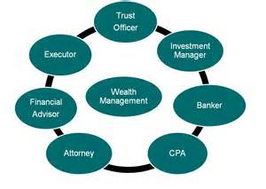


Wealth
Wealth management as an investment-advisory discipline incorporates financial planning, investment portfolio management and a number of aggregated financial services.
Need for Portfolio Management:
It presents best investment plan to individuals as per their income, budget, age and the appetite of risk
It minimizes the risks involved in investing and also increases the chance of making profits
It understands client’s financial needs and suggest the best investment policy for them with minimum risks
It enables the portfolio managers to provide customized investment solutions as per needs of clients

Slide 40

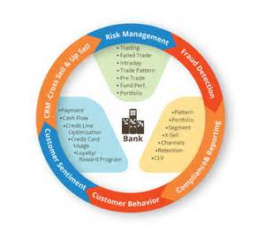

Product Control
Product Control:
Product control are a team responsible for the accounting and financial reporting of a trading desk
It is responsible for monitoring of trades in portfolios, and act as a primary control function
Monitor trading activity to ensure it is within a specified remit
What does a product controller do?
Work in close contact with front office and its traders, risk and valuation units
Exposure to investment banking products allowing to understand why and how banks trades on daily basis
Why are product controllers needed?
Trades go into a profit or loss which has to be assessed daily for abnormalities called 'breaks'
Analyze the figures on the P&L for risk and market trends as well as product performance
It is in both parties interest to ensure there is a good relationship between the controller and the trader
To ensure trader is credited their correct earnings and provide the trader with correct analysis

Slide 41
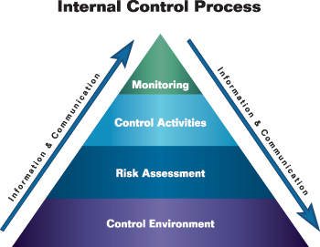
Financial Control
Financial Controls:
Policies and procedures put into place to track, manage and report its financial transactions
It includes income statements, cash flow statements, accounting systems & operating ratios
Proper financial control is associated with the following advantages:
Guide for Future Activities:
Provides guidance to finance manager about how to perform a financial activity
Controlling Finance:
Provides tools to check actual with standard performance; to take appro­priate measures in case of deviations
Increases Managerial Efficiency:
Ensure proper financial discipline in an orga­nization. It also ensures optimal utilization of resources.
Ascertaining Adequate Capital:
Ascertain adequate amount of capital; problems associated with under/over capitalization can be avoided
Maintenance of Financial Stability:
Increases productivity and efficiency of the concern; thereby increases the financial strength of the concern

Slide 42
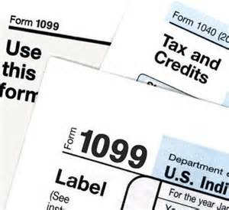
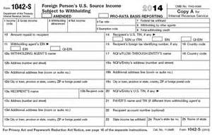

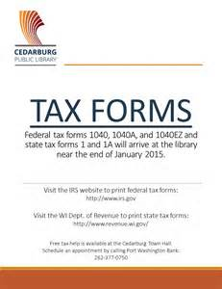
Taxation
The Emergency Economic Stabilization Act of 2008:
When: October 3, 2008,
Why: commonly referred to as a bailout of the U.S. financial system, is a law enacted in response to the subprime mortgage crisis authorizing the United States Secretary of the Treasury to spend up to US$700 billion to purchase distressed assets, especially mortgage-backed securities, and make capital injections into banks
Foreign Account Tax Compliance Act (FATCA):
When: FATCA is effective 1 January 2013 for US financial institutions and 1 January 2014 for foreign (non-US) financial institutions (FFIs)
Why: Designed to prevent US taxpayers from avoiding tax by investing through non-US financial institutions and offshore investment vehicles.

Slide 43

Legal Docs Confirmations – Types of Trade Agreement
Background:
Increased legal risk due to insufficiency or inaccuracy in client data effecting downstream functions
Complexity caused by heterogeneous documents:
Late 1990s to 2000s saw huge growth of bespoke agreements
Global Financial Crisis (2008)
Variations in practices and data inaccuracies highlighted
Solution:
Data scrubbing: Record relevant information
Data Review: Compare data across various CPs and identify deviations & non-structured clauses
Risk identification and assessment: Highlight detailed view of each attribute and the associated risks
Methods:
Data models for many document types developed and customize existing models
Configure tools with custom data capture rules and customize output reports
Digitize documents into parameterized data using web-based capture forms & automatic data-capture tools
Perform remediation/QA through reconciliations and extracted data transferred to client’s internal systems
Analytics performed to understand patterns in current document universe and highlight areas of risk
ISDA Master
Agreement
Supplements to ISDA Master Agreement between two counterparties
Credit Support Annex
Schedule
Master Confirmation
Applicable Industry wide
ISDA Definitions
Trade Confirmation
Trade specific agreements governed by ISDA Master Agreement
Transaction Supplement

Slide 44


Legal Docs Confirmations – Types of Trade Agreement
Importance of Trade Agreements
Develop standardized documentation
Specify legal and netting terms
Deal with regulatory and capital issues in a formal manner
Strengthen risk management by adhering to the agreement
Improve the industry’s operational infrastructure
Increase transparency by building central trade repositories
Facilitate sound collateral management practices
The International Swaps and Derivatives Association (ISDA) is a trade organization of participants in the market for over-the-counter derivatives
ISDA Master Agreement (MA)
Internationally agreed document published by ISDA
Central document around which the rest of the ISDA documentation structure is built
Preprinted master agreement is never altered except to insert the names of the parties
Customized through use of the schedule to the master agreement
Terms covered include Netting, Set-off, Termination
Section 1(c) of the 2002 ISDA Master Agreement states:
"All transactions are entered into in reliance on the fact that this Master Agreement and all Confirmations form a single agreement between the parties ... and the parties would not otherwise enter into any Transactions."
Video link for Trade Agreement

Slide 45
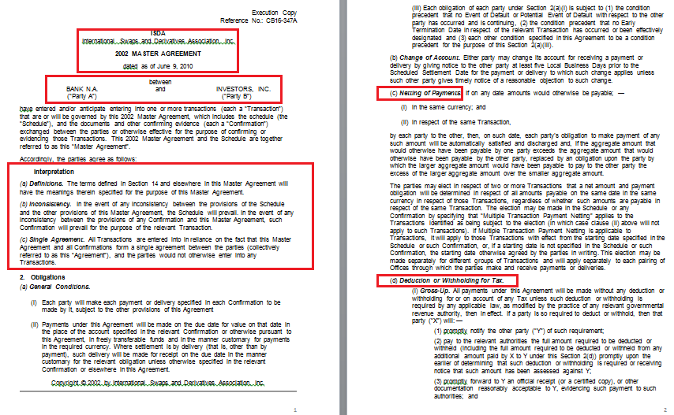
Legal Docs: Types of Trade Agreement (ISDA MA)
Example of Terms – Netting
Party Names
Example of Terms – Tax Withholding
General Terms

Slide 46
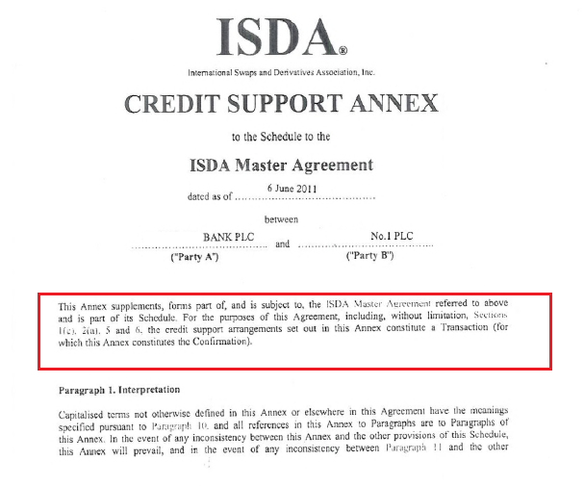
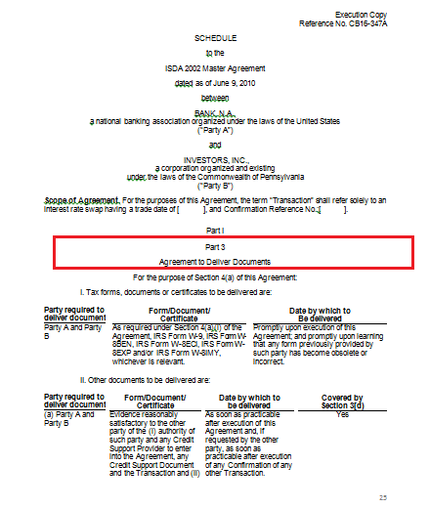
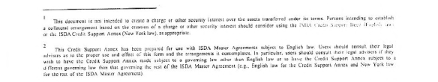
Legal Docs: Types of Trade Agreement (ISDA MA)
Credit Support Annex
Legal document which regulates credit support (collateral) for derivative transactions
Collateral applicable if exposure of one party exceeds an agreed amount
Schedule
Used to make amendments to and customizations of ISDA MA
Additional Terms
Supplement to ISDA MA
Sample – Credit Support Annex
Sample – Schedule

Slide 47
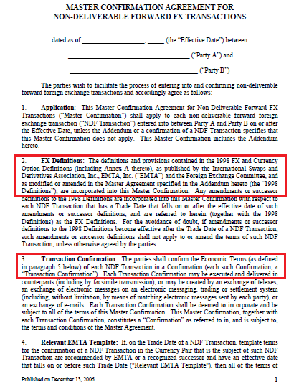
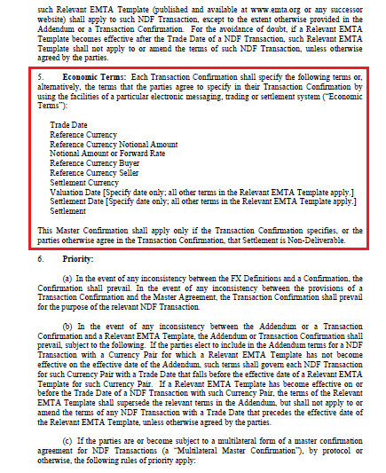
Legal Docs: Types of Trade Agreement (ISDA MA)
Master Confirmation Agreement
Template of standard confirmation as agreed between two counterparties
Specific to asset class
ISDA Definitions
Array of supporting materials for ISDA MA, including definitions
To prevent disputes and facilitate the consistent use and interpretation of ISDA MA
Nine ISDA Definition booklets which apply to nine different classes of derivatives
Applicable ISDA Definitions
Economic Terms to be Mentioned on Confirmation
Mentions the Need For a Confirmation
Sample MCA for non deliverable forward FX Transaction

Slide 48
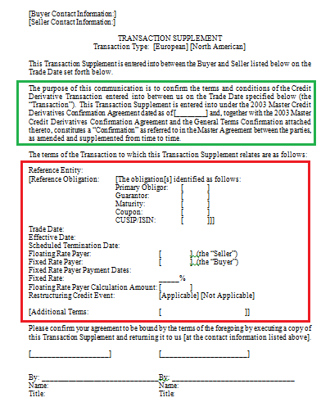
Legal Docs: Types of Trade Agreement (ISDA MA)
Trade Confirmation
Legal contract representing a derivative transaction
"Standard" for vanilla product and non-standard for structured products
Economic and financial payment terms
Conflicts with the schedule or the Master Agreement – Confirmation will prevail
An executed confirmation is legally binding
Transaction Supplement
Short form Agreement
Contains only key economics
Reference to Master Confirmation Agreement
Economic Terms
Sample – Transaction Supplement

Slide 49
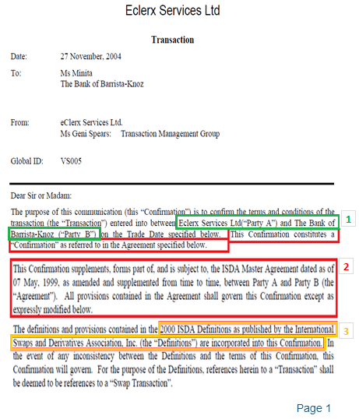
Legal Docs: Trade Confirmation
First section covers ISDA details
Parties involved in Transaction [1]
ISDA Master Agreement is to be used [2]
ISDA Definitions [3]
The next section details the Economics of the trade, here it defines who is paying who, how much and on what dates [4]
“Other Provisions”: In this case we have some Collateral Provisions (detailed in the CSA)
These signature blocks are for both parties to sign [5]
‘To have an executed document, we need both signatures on a confirmation’

Slide 50
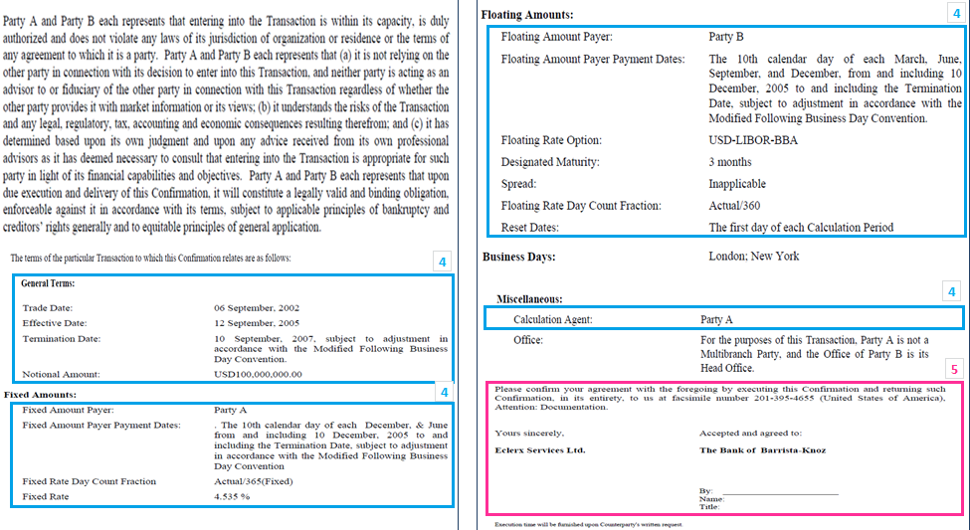
Legal Docs: Trade Confirmation

Slide 51
Investment Bank – Primary Market
Advisor
Arranger
Underwriter
Investment Banks advice?
Issuers on Funding Strategy
Regulatory and Legislative Issues
Stock Exchange
Obtaining Credit Rating
Migration of Best Practices For.eg. Systems and Procedures for Settlement, Clearing, Custodial Services and Reporting
Development of the Swaps, Repo, and Foreign Exchange Markets
Contribution of Arranger?
Manage debt issue to ensure overall success of transaction
Assists Issuer to produce Information memorandum, legal documentation and obtain regulatory approvals from Capital Markets Authority and Stock Exchange
Education of investors, marketing and placement of bonds
Makes market in the securities to support the Issue
Develop interest rate and cross currency derivative applications
Types of Underwriting?
Book Building: It is a process to generate, capture and record investor demand for shares during an initial public offering (IPO)
Best Efforts: Relieve underwriters from responsibility for any unsold inventory in the event that they are unable to sell all the securities.
Bought Deal: Securities offering where an investment bank commits to buy the entire offering from the client company. A bought deal eliminates the financing risk for the company,
Video link for Merger and Acquisition
Notes:
Arranger:
Point 1: (structuring, underwriting and obtaining credit enhancements where required)

Slide 52


Investment Bank – Secondary Market
Market Making
Liquidity Provision
Research
Post Deal Communication
Sales and Trading
Trading can be proprietary, market making, client driven or reverse enquiry
Product Innovation through structured solutions (e.g. derivatives, swaps)
Develop repo / reverse repo markets
Research would include credit reports on issuers
Post deal communication would include historic bond performance

Slide 53

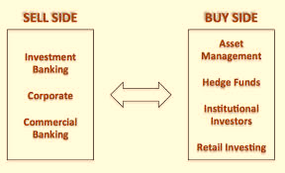
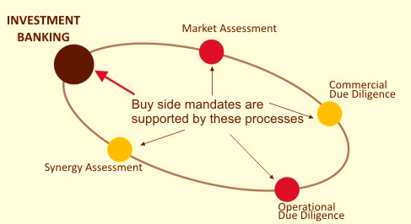
Sell-Side / Buy Side Firms
Sell-Side Firms
Perform investment banking services for corporations, such as stock and debt offerings, loans, etc.
Firms provide recommendations for Buy, Sell, target prices and opinions to public market
Provides research to individual investors
Buy-Side Firms
Firms participate in smaller number of transactions, aim to profit from market movements and accruals
Investing institutions such as mutual funds, pension funds and insurance firms that buy large portions of securities
Research produced by buy-side analyst is usually unavailable outside of the firm
Buy-side analysts often source research from sell-side, and then use this information as a base for their own research
Video link for Buy side vs. Sell side

Slide 54
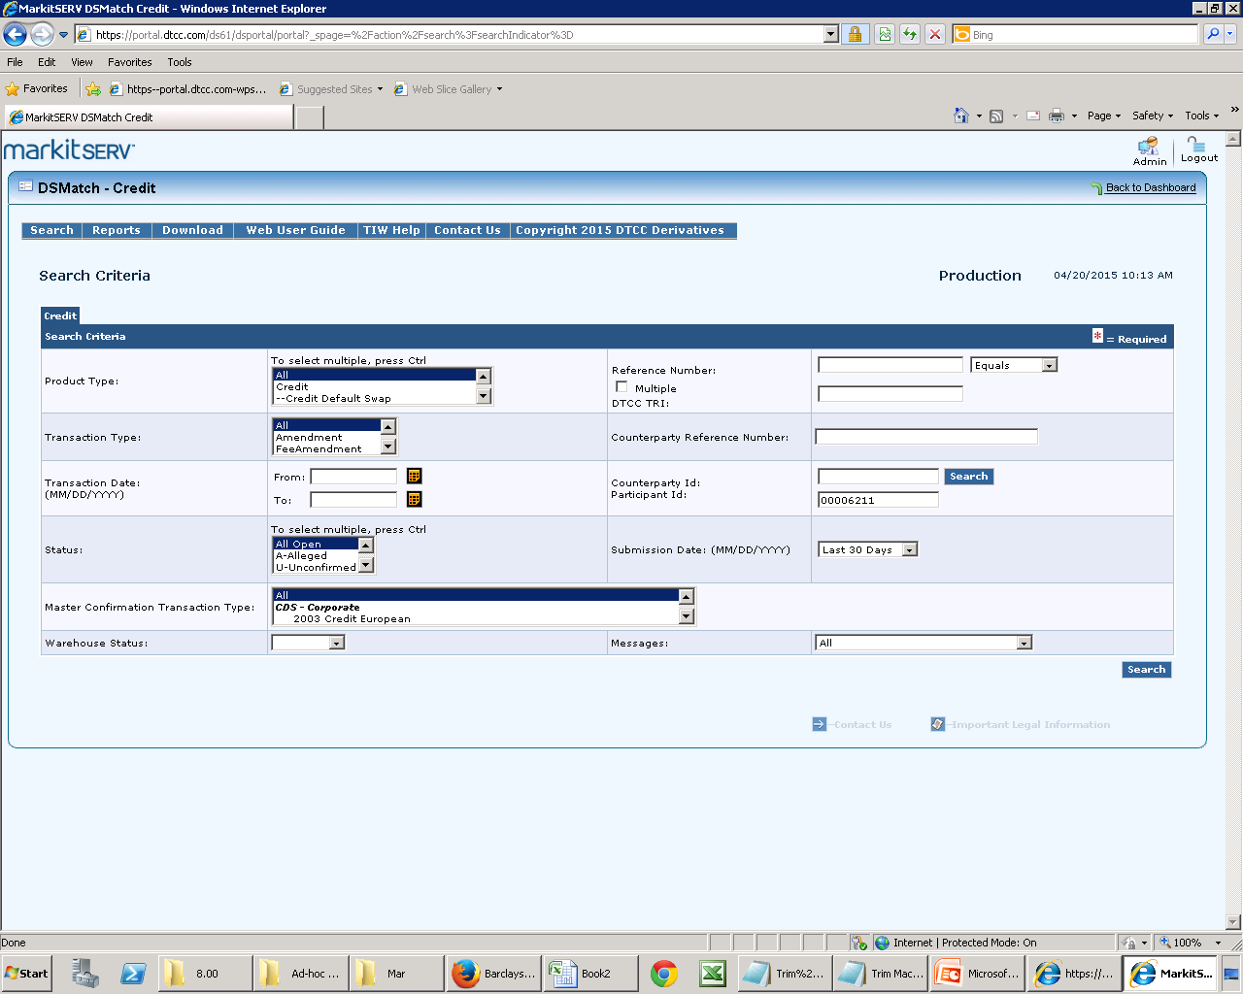
Commonly Used Platforms
Technology has evolved and has helped banks to run their day to day operations smoothly. Banks now-a-days invest heavily in the information technology across the banking operations.
Commonly used platforms in the capital markets are as follow:
DTCC
Markit Wire
Bloomberg
CLS
Reuters
Intellimatch
EGUS
EGAIN
The Depository Trust & Clearing Corporation (DTCC) is the world’s largest financial post trade infrastructure organization. DTCC through its subsidiaries, provides clearing, settlement and information services for:
Equities
Corporate and municipal bonds
Government and mortgage-backed securities
Money market instruments
Over-the-counter derivatives

Slide 55
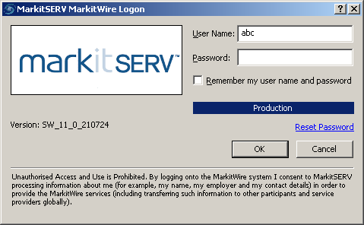

Commonly Used Platforms
MarkitWire (formerly SwapsWire) delivers real-time legal confirmation, trade capture and STP for sell-side and buy-side firms, inter-dealer brokers (IDBs) and fund administrator, for OTC rates, equities and commodities products.
Includes support for all trade life-cycle events and innovative functionality to handle novation and allocation.
Current coverage:
Credit
Equity
FX
Interest rates
Bloomberg is the premier source for global business and financial information, and a leading provider to businesses. Delivering data, news and analytics through innovative technology.
The Bloomberg Terminal is a computer system provided by Bloomberg L.P. that enables professionals in finance and other industries to access professional service through which users can monitor and analyze real-time financial market data and place trades on the electronic trading platform.

Slide 56
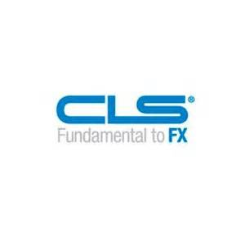

Commonly Used Platforms
CLS plays a fundamental role in the foreign exchange (FX) market – it operates the largest multicurrency cash settlement system to mitigate settlement risk for the FX transactions of its members and their customers.
Owned by the world's leading financial institutions, CLS settles payment instructions relating to underlying FX transactions in 17 major currencies and certain other transactions that result in one-way payments in a subset of those currencies.
Reuters enterprise solution manages information as it flows through the day which is no trivial challenge. With more higher volumes and velocity of data to process, along with more complex trading strategies, and regulatory requirements to navigate, you need the right trading technologies to support your operations.
Thomson Reuters Enterprise Platform enables to master that complexity. Integrate data from any source, to enrich and validate those sources of data, to create proprietary prices, analytics and other content.

Slide 57
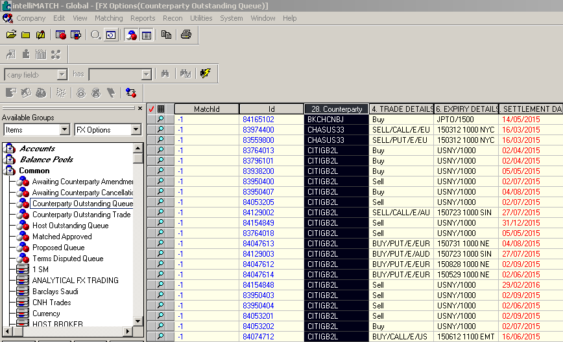
Commonly Used Platforms
SunGard’s IntelliMatch operational control is a suite of reconciliation software solutions that helps you better manage the accounting, trading, transactional and reconciliation activities that support your core business while reducing cost and risk.
It incorporates enterprise reconciliation, nostro reconciliation, confirmation matching, ATM and card reconciliation, payments investigation, exception management software and derivatives reconciliation software, plus business intelligence and workflow solutions.
eGAINS matches give-up trades to give-up agreements using the executing and carrying exchange firm codes, and account numbers.
After a give-up is matched to an agreement, eGAINS finds the appropriate give-up fee for that transaction, using detailed criteria such as futures / options, spread codes and product codes.

Slide 58
Trade Life Cycle

Slide 59

Trade – Key Concepts
A trade is a legal contract between two counterparties.
It involves an exchange of security for cash
Takes place either on- or off-exchange.

Slide 60







Life Cycle of a Trade
Bank ABC
Bank XYZ
Reporting
Trade Execution
Shared Services
Front office
Front office
Trade Booking
Allocations
Trade Enrichment
Exception Management
Reconciliation
Securities Lending
Margins
Middle Office
Middle Office
Confirmations
Settlements
Billing & Brokerage
Clearing
Back Office
Back Office
Video link for Life Cycle of a trade
Notes:
Shared Services: Product Control - Financial Control - KYC - Taxation- Wealth
Reporting: Risk Reporting - Regulatory Reporting - Client Reporting - Exceptions Reporting - Management Information - Analytics

Slide 61
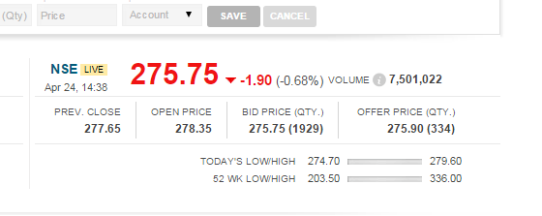
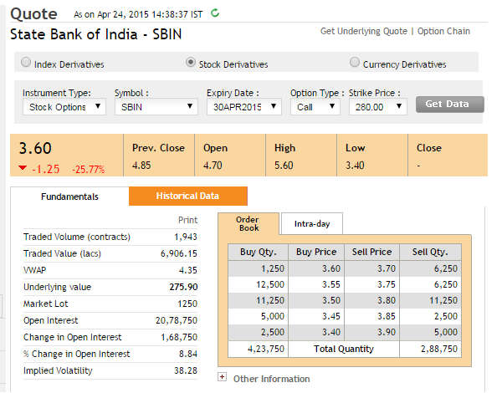
Trade Execution – Key Concepts
The process of filling your order is known as “Trade Execution”
Where and how your order is executed can impact the overall costs of the transaction, including the price you pay for the underlying asset
Order Driven Market
A financial market where all buyers and sellers display the prices at which they wish to buy or sell a particular security as well as the amounts of the security desired to be bought or sold.
Quote Driven Market
An electronic stock exchange system in which prices are determined from bid and ask quotations made by market makers, dealers or specialists.
Video link for Trade Execution

Slide 62

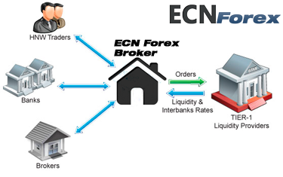
Electronic Trade Execution
Electronic Communication Network
ECN is an automated system that matches “Buy and Sell” orders for securities
Major “Brokers and Individuals” trade among themselves without going through a “Middleman”
Brokers make money by “Charging a fee” for each transaction
ECN makes it possible for investors in different geographic locations to “quickly and easily trade with each other”

Slide 63
Trade Booking / Allocation
Trade Booking
Information of the trades executed need to be captured in the banks systems for record keeping purpose
E.g. Citi selling bonds to JPM need to be recorded by each of the bank for appropriate settlement in the future
Trade Allocations
Block trades are allocated as per the account details received from Client
E.g. JPM wants the delivery of the bonds in two separate entities hence the block sold by Citi will be allocated in the two required accounts of JPM

Slide 64
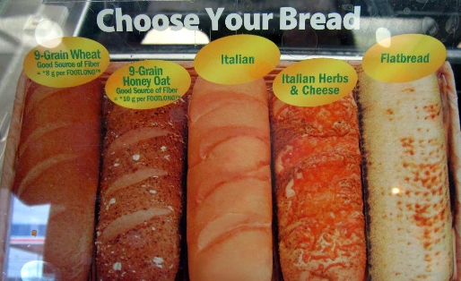

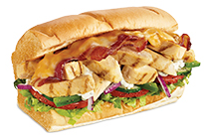
Trade Enrichment – Key Concepts
Traders would typically write the basic economic parameters that were decided upon with the counterparty on a piece of paper called as the trade blotter
Static Data is added to the trade
Any special terms and conditions of a trade are captured in the risk systems
The function where the trade details are captured in the risk systems is called as trade enrichment.
Complete trade information updated in the booking system flows downstream
Any further activities that take place on the trade – drafting, confirmation, settlement etc. is dependent on correct trade enrichment
Essential Trading Information (Economic terms entered by Trader)
Trading Book
Trade Date
Trade Time
Value date
Quantity
Security
Price
Counterparty

Slide 65
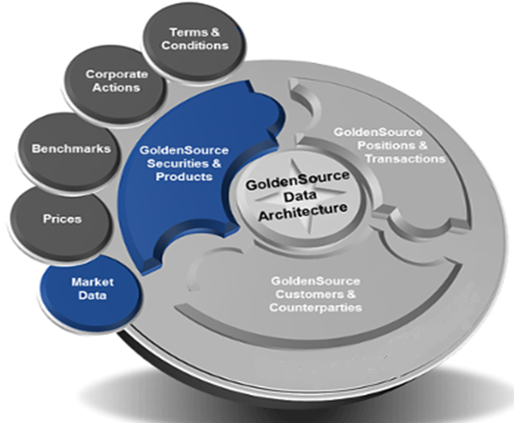
Trade Enrichment – Static Data
Automatic Enrichment
Major Investment Banks setup the trade enrichment to takes place automatically via direct feed from various sources. That reduces the risk of any manual errors taking place.
Consequences of incorrect Static / Trade Data
Delayed Confirmations
Unmatched transactions
Settlement failure
Incorrect fee/ PnL calculations
Reduced STP (Increased cost)
Poor Reporting (Regulatory impact)
Static Data
Information which will remain consistent despite any customization to a trade that might have been decided between the traders
Source of Static Data
Where possible, financial institutions try and create a core of “Golden Source” static data to avoid conflicts in inter-dependent systems
Video link for Trade Enrichment

Slide 66
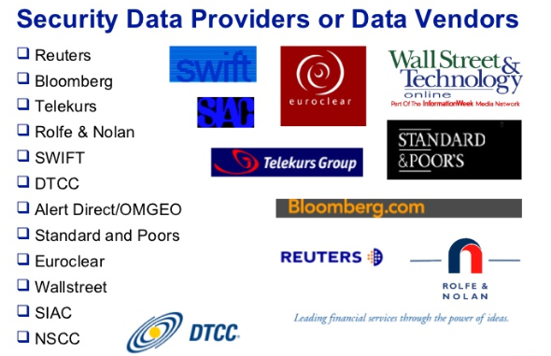
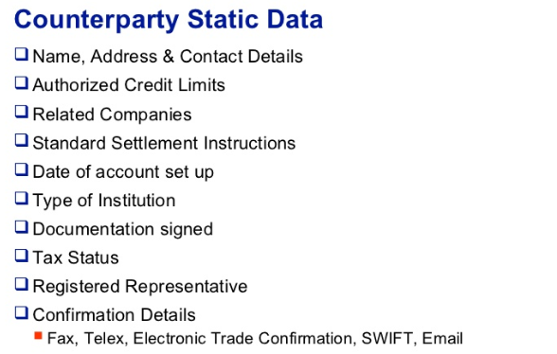
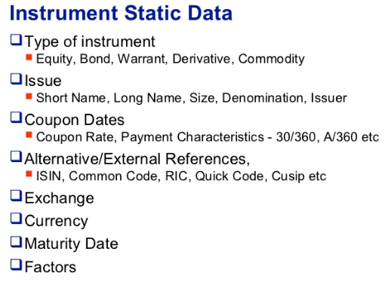
Trade Enrichment – Static Data
The Reference Data team in the bank is primarily responsible for updating and maintaining static data.
Examples:
Client Onboarding team will enter the information for new clients
Corporate action team to capture any changes in legal structure of clients
Product data from external sources – Companies specialize in gathering and distributing securities /
Market data to institutions via electronic file feeds, internet, on site terminals

Slide 67
Trade Exception Management
Investigation & Exception Management
Investigation & resolution of exceptions / issues causing obstruction in trade flow
E.g. Resolution of trade settlement issues, resolution of trades with errors rejected by Mainframe systems etc.
The general fields which are touched for these functions:
Trade Date
Value Date
Quantity
Security information (Security Code)
Price
Counterparty Information (Counterparty Code)
Standard Settlement Instructions

Slide 68


Risk – Booking, Allocation, Enrichment & Exceptions Management
Process Background
Trades executed by traders need to be booked in systems for record keeping
Simultaneously appropriate quantities need to be distributed / allocated into multiple accounts
Trades need to be enriched with missing or updated information
Exceptions in trade flows need to be resolved for an accurate entry in the downstream systems
Error Description
Email communication from counterparty was missed
Trade was booked to incorrect counterparty
Incorrect quantity was allocated in sub accounts
Reason for errors
Manual error due to not following agreed process
Mis-understanding of request from Middle Office
Outcome
Confirmation sent to wrong counter party or incorrect trade details
Account will show incorrect exposure
Impact
Information Security breach & reputational loss
P & L impact due to incorrect balances in accounts
Regulatory Impact

Slide 69
Reconciliation – Key Concepts
Reconciliation: To ensure data across different systems & documents are in sync by comparing values of individual fields
Some of the basic Trade Validations done by middle office are:
Trade Date
Value Date
Quantity
Security information (Security code)
Price
Counterparty Information (Counterparty Code)
Standard Settlement Instructions
Failure To Capture trade details is mainly on account of:
Missed Trade – The trade is missed
Deleted Trades – The trade is booked and deleted on the same day by the trader
Incomplete Trades – The data required to book the trade is incomplete
Reasons to not book a trade on T0:
Missing Information
Incomplete Information
Video link for Reconciliation

Slide 70

Reconciliation Benefits
Benefits:
Checks on Execution Error
E.g. Funds misapplied to wrong accounts are rectified
Checks Control Errors
E.g. Control check on accounting records
Assists in Exception Reporting
E.g. Flagging amounts rejected / accepted by counterparty
Notes:
Executions Errors
Control Errors
Exception Reporting

Slide 71




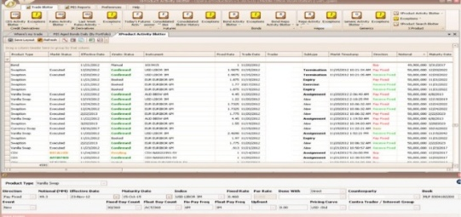
Types of Reconciliation – Overview
Reconciliation can be performed between any two reports or systems in the whole trade life cycle. A broad categorization is given below:
2-way recon: Bank’s details against Counterparty / Broker details or Reconciliation between two systems
Case 1: Broker Recon – Broker recap vs. Bank’s booking system
Involves a check if the main economic parameters between the broker and the banks systems match
Required to ensure the execution of the trades are per the banks instructions
Case 2: Position Recon - Client instruction vs. Middle Office Monitor (or an export from the system)
Recon of positions is required when there is continuous buying and selling of securities
The EoD balances need to match the booking systems & the bank’s instructions
Broker
Bank’s system
Client’s Instruction
Middle Office Monitor

Slide 72

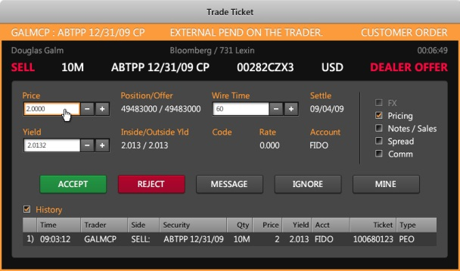
Types of Reconciliation – Overview
3-way recon: Performing a check of a Bank & Counterparty / Broker data with Bloomberg tickets
Case 1: Client instruction vs. Counterparty recap vs. Bloomberg Ticket
N-way recon: E.g. -Perform checks to see if multiple downstream systems have the correct data
Case 2: Booking System vs. Payment System vs. Broker Confirm vs. Term Sheet
These checks are required to ensure the trade impressions on all the systems and documents match
Client’s Instruction
Counterparty Recap
Bloomberg Ticket
Booking System
Payment System
Broker Confirm
Term Sheet

Slide 73


Risk – Reconciliation
Process Background
Trade information travels via multiple sources leaving its impression across
Information across these sources need to match
E.g. Confirms received from the brokers need to match the internal booking systems
Information across systems need to match
Information on the traders blotter need to match the down stream systems
Error Description
Failed to interpret the abbreviation accurately leading to failure in identifying trade discrepancy
Break identified but not highlighted & mis-interpretation of the direction of the trade
Reason for errors
Manual error due to lack of knowledge of the process
Being lax and not following the agreed process
Outcome
Settlement issues in the end of the trade life cycle
Delay is settlement of trades
Impact
Approval of wrong payment in the system leading to P/L impact
Reputational loss for the client
Regulatory impact

Slide 74
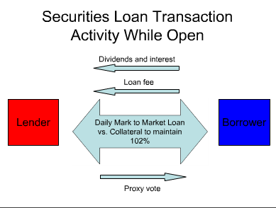

Securities Lending – Key Concepts
Securities lending
Investment strategy where owners of securities, loan their assets to generate additional return
Loans are collateralized usually with cash or highly liquid securities
Collateral value is generally 102% or 105%
Transfers ownership of the securities including the voting rights but retains the economic benefits
Cash dividends and market value continue to accrue to the lender
What is Securities Lending?

Slide 75


Who Borrows and Why?
Who Borrows?
Broker / dealer firms
Hedge funds
Institutional investors
Who Lends?
Mostly buy-and-hold investors of actively traded securities
Insurers
Pension funds
Mutual funds
Endowment Funds
Motivation for Borrowing?
Cover a short position
Hedging
Market Making Requirements
Motivation for Lending?
Generates incremental return
Meets expense of holding a portfolio of securities
Monetizes the premium from holding hard-to-borrow securities

Slide 76


Risk – Securities Lending
Process Background
Trades are reconciled across functions; i.e. in Billing, Contract Compare, Product Support etc.
Breaks appear due to parameter mismatch either with counterparties or with intersystem journals, accounts
Escalation Protocol to be followed for Breaks identified and sent to correct teams with accurate information
Error Description
Actual break not identified
Incorrect remediation by sending incorrect trade details
Break sent to incorrect team
Break not appropriately escalated
Reason for Error
Manual Negligence, Typo (1,2,3,4)
Procedural gaps (1,2 and 4)
Communication Gap (3)
Outcome / Impacts:
PnL misstatements (Incorrect account identified for cash related break, financial risk for trader)
Billing Differences (Unresolved / Incorrectly resolved breaks create monthly invoice differences)
Ageing of breaks (Outstanding risk to firm, exposure risk)
Firm books not being balanced (Audit risk)
Reputational loss

Slide 77



Margins – Key Concepts
What is Credit Risk?
Uncertainty in a counterparty's ability to meet the financial obligations
Potential ways to deal with credit risk:
Get somebody else to reimburse your credit losses
The credit risk of the transaction is passed on to a third party, either partially or wholly, which party may in return receive some defined payments
E.g.: A passes the Risk to B (Third Party), A may receive some defined payments
Obtain the right of recourse to some asset of value that you can sell in the event of default on the transaction
Ideally firms would like an asset of stable and predictable value that can be sold quickly and easily if the need arises. “This is collateralization”

Slide 78

Collateralization
Collateral is a form of security to the lender in case the borrower fails to pay back the loan

Slide 79



Types of Collateral
Typical assets used as collateral include:
Cash
Debt and equity securities
Letter of credit etc.
Except for cash collateral, these carry the contingent credit risk of non-performance by the third party
E.g. Default by issuer of the debt securities

Slide 80



Collateral Example
Examples of Collateral,
If one opens a mortgage, the collateral would be the house
In margin trading, the securities in your account act as collateral in the case of a margin call
Assets pledged as security / collateral for a loan will be sold in the event of default

Slide 81

Details of Collateralization
Collateralization is a risk mitigation process that enables different entities to transact with each other
What is Collateralization Agreement?
When there are “two parties involved in ‘N’ transactions” with each other, then in order to “mitigate their respective credit risks” they enter into a collateralization agreement (called CSA)
How is it done?
Both parties sign a “Master Agreement” that encompasses the terms and conditions which will be applicable to all the transactions that these parties get into with each other.
A CSA is signed to cover all trades falling under this “Master Agreement” and collaterals are then posted by either/both parties depending upon the terms defined as per CSA
Collateral Management
Refers to the handling of all tasks related to the monitoring of collaterals posted by a borrower
Mark to Market
The act of recording and/or updating the price or value of a security, portfolio, or account to reflect its current market value rather than its book value

Slide 82


Risk – Margins
Process Background
Team posts journal entries for the amount received and paid to client
Need to enter the amount, account number, currency etc. manually in the system
Error Description
While making entries in the system incorrect amount was keyed in
E.g. Typing in $500.000 keyed in $500,000
Reason for Error
Manual error due to
No knowledge of the process or
Being lax and not following the agreed process
Outcome
Wrong call will get settle with client that will impact on client exposure a/c
Account will show wrong exposure numbers
Approval of wrong payment in the system
Impact
Risk of incorrect payments being done leading to P/L impact
Reputational loss for the client
Regulatory Impact

Slide 83
Confirmation – Key Concepts
Trade confirmation is the process by which the two counterparties to a trade agree and sign off on the terms as mentioned in the document.
Trade Confirmation provides specific terms for a particular trade over and above the ISDA Master Agreement
An executed confirmation is legally binding
Both parties have agreed to the terms & conditions
Future disagreements will be checked back to the executed Confirmation
Parties can confirm trades in two ways:
Manual Confirmation: Under manual verification, either one or both parties verbally affirm the trade and send out paper confirmations via electronic fax/ email to the other counterparty for their agreement and execution. This document acts as a legal agreement of the trade between the two parties.
Electronic Confirmation: Electronic Trade Confirmation is an automated process wherein both counterparties submit their trade on a third party platform on which these are compared, matched and executed.

Slide 84

Confirmation Life Cycle (Manual)

Slide 85


Confirmation Life Cycle (Manual)
The Confirmation Life Cycle has four key processes:
Affirmation
Affirming trade details with counterparty
Bank B calls / mails Bank A to confirm a trade that has taken place between them
Bank A studies details and searches for similar trades within its own systems
If a trade is found with exact trade details, then Bank A affirms the trade
Drafting
Drafting a confirmation acts as legal proof of an OTC trade
Drafting process can be
Automated / STP
Semi-automated
Manual
Signature of the firm’s representatives is added on the confirmation
Confirmation is dispatched to the counterparty via email/ electronic fax

Slide 86



Confirmation Life Cycle (Manual)
Incoming
Review
Indexing of trades received in electronic fax queue / mail
Incoming Doc received
Outgoing confirm countersigned by counterparty
Reconciliation
Doc vs. Doc
Doc vs. System
Doc vs. Doc vs. System
Bank will countersign incoming confirmation only if it agrees to all terms therein
Trade is executed when both parties agree and sign the confirmation
Chasing
Chasing counterparty for Incoming confirmations
Chasing internal teams and counterparties to resolve discrepancies highlighted between the bank’s booking system and counterparty confirmation
After all discrepancies are resolved, a clean version of the confirmation is exchanged
Both parties to sign the confirmation and execute the trade

Slide 87

Confirmation Life Cycle (Electronic)

Slide 88





Confirmation Life Cycle (Electronic)
Increased focus on confirming trades on electronic platforms to reduce manual intervention and achiever faster confirmation
For trades to be confirmed on electronic platform:
Both counterparties should be signed up on the relevant platform
The particular product type should be eligible to be confirmed on the relevant platform
The trade should be agreed upon standard terms
Straight through processing is a process of managing trades throughout the trade life cycle automatically without human intervention
Can STP Fail?
If the trade is electronically eligible, it may fail STP due to the following reason:
Incomplete trade details when trade details do not flow correctly from the static data sources
Incorrect channel settings in the confirmation system
Third Party Confirmation Platforms
The Depository Trust & Clearing Corporation (DTCC)
Swaps wire / Markitserv
STP
Trade Booked in System
Trade Confirmed

Slide 89

Regulatory Requirements
The Dodd-Frank Act (fully known as the Dodd-Frank Wall Street Reform and Consumer Protection Act):
United States federal law that enforces financial regulatory processes that enforce transparency and accountability while implementing rules for consumer protection.
Regulation | Asset Class | Market Participants | Execution targets
Commodity Future Trading Commission | CDS / IRS | Swap Dealers / Major Swap Participants | Trade Date + 2 Days
 | Commodity / Forex / Equity | Swap Dealers / Major Swap Participants | Trade Date + 2 Days
 | CDS / IRS | Others | Trade Date + 3 Days
 | Commodity / Forex / Equity | Others | Trade Date + 4 Days

Slide 90

Regulatory Requirements
European Market Infrastructure Regulation (EMIR):
It is a European Union regulation designed to increase the stability of the over-the-counter (OTC) derivative markets throughout the EU states
Common rules for central counterparties (CCPs) and for trade repositories; measures to reduce counterparty credit risk and operational risk for bilaterally cleared OTC derivatives
Regulation | Asset Class | Market Participants | Execution targets
EMIR | CDS / IRS | Financial Counterparties and Non Financial Counterparties | Trade Date+ 1 Day
 | Commodity / Equity | Financial Counterparties and Non Financial Counterparties | Trade Date + 1 Day
 | CDS / IRS | Others | Trade Date + 2 Days
 | Commodity / Equity | Others | Trade Date + 2 Days

Slide 91

Risk – Confirmations
Process Background
Affirming key economic parameter with counterparty
Prepare the confirmation and dispatch to counterparty
Reconciliation of confirmed with System
Liaising with internal teams and getting it executed
Error Description
Mail sent to incorrect counterparty
Incorrect parameters
Incorrect trade details / incorrect dispatch
Missed / highlighted breaks
Reason for Error
Manual error, System error
Outcome
Trade confirmation dispatched to counterparty with incorrect details
Delayed execution due to iterations in trade document
Impact
Incorrect cash flow amount calculation based on the incorrect notional amount
Risk of incorrect payments being done leading to P/L impact
Reputational loss & Regulatory impact
`

Slide 92

Trade Settlements – Key Concepts
Trade Settlement is the act of exchanging securities and cash between buyer and seller
Trade settlement typically occurs at the STO’s (Stock Trading Organization) custodians in various financial centers
Process of Trade Settlements:
Trade indicates Agreement
Settlement indicates delivery
Custodians receives instructions from the STO and messages from the counterparty’s custodian
Custodian proceeds with settlement process once all instruction parameters match and agree

Slide 93

TLC – Settlement of Trade
Settlement Instructions
Depository
Settlement Instructions
Investment Bank A
(Seller)
Investment Bank B
(Buyer)
Seller
Custodian
Validation
Buyer
Custodian
Securities
Payment
Status Matched and Unmatched
Status Matched and Unmatched
Matching
Post Settlements
Post Settlements
Ledger and Statement
Ledger and Statement
Nostro Recon
Settlement
Nostro Recon
Market Regulations
Regulations Governing Settlement
CSD Regulations
EMIR Regulations

Slide 94


Trade Settlements and Settlement Instructions
Trade Settlement is the act of exchanging securities and cash between buyer and seller
The intended date of delivery and payment – Contractual Settlement Date
The date that the exchange of securities and cash is effected – Settlement date or actual settlement date
Settlement Instructions are used to communicate the movement of securities and cash to the custodian

Slide 95


Methods of Communicating Trade Instructions
Unlike in the past when certificates were physically delivered between the counterparties
Electronic means used to transmit settlement instructions:
Telex
Used for sending text-based messages - not fully secure
Fax
Telephonic transmission of scanned printed material. – prone to security issues
Email
Most common method. – not fully secure even if encrypted
Telephone
Used in combination to one of other methods to increase the data security
SWIFT: Society for Worldwide Interbank Financial Telecommunication (SWIFT)
Provides a network to allow transfer of financial messages
Most secured environment – preferred by banks globally
Operates around the clock
SWIFT
Video link for Communication Trade Instructions ?

Slide 96
Custodian Statements and Accounts
Custodians are mandated to send account statements to their clients highlighting details of account transactions
Two primary accounts held with the Custodians – Nostro and Vostro accounts
Nostro Accounts/Mirror accounts: (Our account with you)
Nostro is derived from Latin term “Ours”. A Nostro is our account of our money, held by you.
An account at a foreign bank where a domestic bank keeps reserves of a foreign currency
Example: An account of SBI Bank (an Indian bank) with a London bank in GBP currency is a Nostro A/C for the Indian Bank.
Vostro accounts / Loro Accounts / Real accounts: (Your Account with us)
Vostro is derived from the Latin term “Yours”. A Vostro is our account of your money, held by us.
A Current account maintained by a foreign bank with domestic bank in local currency
Example: An account of London Bank with an Indian Bank for INR currency is a Vostro account for the Indian Bank

Slide 97
Settlement Types
Full Settlement | Partial Settlement | Securities Only Settlement | Cash Only Settlement | Cross Currency Settlement
Entire Quantity of Securities delivered & received | Partial delivery of cash & security | The delivery or receipt of securities | Settlement is done on cash basis only | Settles trade in the ‘natural’ or ‘trading’ currency of the specific security
Fill amount of cash received | Also known as “partial delivery” “partial settlement” or “settlement splitting” | The delivery is independent of cash | Free of physical delivery of securities | Eliminates foreign exchange risk

Slide 98


Gross vs. Net Settlements
Gross Settlements
Settling a trade with individual payment or Receipt of funds is gross settlement
Flow of transaction without Netting
Party A to pay $80 to Party C
Party C to pay $90 to Party B
Party B to pay $100 to Party A
Net Settlements
Netting means to allow a positive value and negative value to off-set and partially / entirely cancel each other
Avoids multiple cash flows, saves swift charges and reduces settlement risk
Flow of transaction with Netting
The Parties net off the transaction meaning who ever owes more
make the payments and settle the transaction
Party A receives $20 i/o receiving $100 from B and paying $80 to C
Party B pays $10 to Party A i/o receiving $90 from C and paying $100 to A
Party C pays $10 Party A i/o receiving $80 from A and paying $90 to B

Slide 99





Payment Systems Overview
An operational network that links bank accounts and provides functionality for monetary exchange
Its technical efficiency determines efficiency of usage of transaction money in the economy, and associated risk

Slide 100

Post Settlements – Settlement Fails
Definition Of Fails
A failed trade is any securities transaction that does not settle on value date
A fail becomes “aged” when its settlement exceeds the agreed time period following the original settlement date
Why Trades Fail
Unmatched Instructions
Instructions not received by Custodian
Instructions remain unmatched on value date
Insufficient Securities / Cash
Securities to be delivered are insufficient or unavailable
Or the Cash, credit line are insufficient
Costs of borrowing vs Fails
When the cost of borrowing the assets >= cost of failing to deliver, market participants may find it preferable to fail

Slide 101

Nostro Reconciliation – Key Concepts
Through the process of reconciliation banks can track:
Status of cash received / receivable and the amount paid / payable
Unsettled transactions either in mirror or in actual Nostro accounts
Banks reconcile Nostro accounts immediately on receipt of the statements from correspondent banks to:
Enable them to reconcile the same with their Nostro mirror balances
Take quick remedial action in case of unsettled / discrepancy in transactions
Access to Users:
Only authorized users permitted to perform this activity
Generally two independent teams from the bank are involved
Treasury Back office – Handles settlements
Middle Office – Takes care of Nostro reconciliation

Slide 102
Regulations: Central Securities Depositories
National Central Securities Depositories (CSDs) are
Key institutions that perform the vital post-trade process of securities settlement
Hold records of securities accounts and transactions
Following 2008 financial crisis, the European Commission (EC) decided that:
CSDs harmonize their practices
Improve the safety and efficiency of transaction settlement
The CSD Regulation introduces a common set of rules to harmonise 'settlement discipline' across EU
Prevent settlement fails
Address these fails when they occur
Shortened Settlement cycle reduces additional margin and liquidity economic volatility
T+2 (tentative go-live June 15) helps foster reduction of counterparty risk by:
Moving trades more quickly to settlement
Enabling capital to be freed up faster for reinvestment
Reducing credit and counterparty exposure

Slide 103
Post-trading / Clearing and Reporting (EMIR)
European Markets Infrastructure Regulation (EMIR)
Came into force on 16 August 2012
Introduced requirements aimed at:
Improving transparency of OTC derivatives markets
Reduce the risks associated with those markets
Establishing organizational conduct of business and prudential standards for both trade repositories (TRs) and central counterparties (CCPs)
EMIR requires that:
OTC derivatives meeting certain requirements
All derivatives transactions need to be reported to trade repositories (TRs)
Key EMIR provisions:
Reporting obligation for derivatives contracts
Requirements for trade repositories (TRs)
Clearing obligation for OTC derivatives and risk mitigation techniques for non-cleared OTC derivatives including non-financial counterparties (NFC) obligations
Requirements for clearing houses / central counterparties (CCPs)

Slide 104


Risk – Settlements
Process Background
Process of exchanging cash with the seller and the seller transferring ownership of the security to the buyer within the agreed timeframe
Error Description
Trade amount booked incorrectly in the system and overlooked by the settlements team while reconciling
Trade getting settled with incorrect counterparty
Incorrect netting of transactions E.g. Total 27 trades against a CP that were to be processed as a netting transaction i.e. 11 trades payable & 16 trades Receivable. Analyst incorrectly processed only 11 payable trades as gross
Reason for Error
All emails not check properly
Information available in the systems not reviewed properly before taking the final action
System issues e.g. macro not working
Outcome
Incorrect payment to the counterparty and Incorrect outstanding balances leading to incorrect reporting
Impact
Incorrect / overpayment to cpty leading to client escalation
Financial loss to client leading to escalation
Risk of incorrect payments being done leading to P/L impact
Regulatory Impact & Reputational loss

Slide 105

Brokerage & Billing – Key Concepts
A firm that acts as an intermediary to buy or sell goods or assets for clients
The duties of brokers include:
Completing all necessary legal paperwork
Collecting money from purchaser and transferring to seller
Brokers can be classified into two broad categories:
Executing Broker
Assesses appropriateness of orders
Finalizes and processes order on behalf of a client
Clearing Broker
Acts as a liaison between investor and clearing corporation
Helps to ensure trade is settled appropriately and the transaction is successful
Client
An Individual, Corporate or Banker who is interested in buying or selling of securities
Exchange
Marketplace where financial instruments like stocks, commodity or currency are traded
Financial Market
OTC Trading
Listed Trading
Executing Broker
Clearing Broker
Executing Broker

Slide 106

Stages in Brokerage Life Cycle
Step 1: Client gives request for buying or selling security / financial instrument to executing broker
Step 2: Executing broker executes order on exchange
Step 3: Executing broker intimates clearing broker of the executed order
Step 4: Clearing broker extracts the details from exchange
Step 5: Depending on # 3 & 4, clearing broker debits or credits client a/c based on client’s buy / sell order.
Clearing broker also debits client a/c with executing and clearing brokerage.
Step 6: Executing broker generates brokerage invoice and sends it to clearing broker for payments
Step 7: Clearing broker reconciles invoice sent by executing broker with client instructions, resolves exceptions (if any) and transfers the amount to the executing broker

Slide 107

Risk – Brokerage & Billing
Process Background
Broker trade recap (invoice) should be reconciled with internal client data
Accurate reconciliation would need analyst to match all critical parameters
Important parameters are Date, Price, Exchange Rate, Account #, rate, lot size, brokerage and brokerage currency
Error Description
Trade reconciliation by relaxing any of the important parameters
Leads to incorrect reconciliation and draw down of accrual
Reason for error
Manual miss / negligence / training gap
Analyst not following process checklist
Outcome
Incorrect payment to the broker
Incorrect outstanding balances leading to incorrect reporting
Impact
Incorrect / overpayment to broker leading to client escalation
Financial loss to client leading to escalation
Risk of incorrect payments being done leading to P/L impact
Reputational loss

Slide 108



OTC Clearing – Key Concepts
Process under which OTC contracts for various asset classes will be cleared through a Central Counterparty
To mitigate the risk of default by any of these parties, the clearing house charges an “initial margin”
The trades are marked to market daily
Collateral that is collected or returned by the CCP based on the MTM value is called “Variation margin”
Variation Margin obligation can be fulfilled only by Cash
Clearing Fee is charged by CCP at the outset of a trade
Notes:
Charges

Slide 109



















Clearing Operations: Process Flow
Client on-boarding and confirmations
Complete mandatory documentation for a new client
Perform rigorous checks on documents
Escalate in case of difference
Trade confirmation and set up for valuation and margin calculation
Capture daily trade level MTM details, IM and VM calls
Prepare IM/VM call reports; Distribute corresponding call notices to clients
Investigate and provide resolution on disputes
Margin Calls
Reconcile positions, net margins, coupon payments and clearing fees with CCP
Investigate on breaks and send reconciliation reports for resolution
Reconciliations
Approve VM recalls and cash collateral payments
Close VM calls on receipt of cash/ collaterals
Prepare and send fail station reports for non receipt of payments to clients
Settlements
Video link for Clearing House

Slide 110


Shared Services
Product Control
Accounting and financial reporting of a trading desk (Daily Profit / Loss with specific desk)
Monitor trades in the portfolios to ensure it is within a specified remit
Financial Control
Prepare financial reports, such as balance sheets and income statements
Compliance audits, monitor internal controls, participate in budgeting process and analyze financial data
Data Management Services
Perform KYC for New Clients, remediation and renewals for clients across risk types (Low, Medium, High)
Details like legal name, registration address, nature of business country of origin etc. are verified
Taxation
Manual remediation and functional testing services for Cost Basis Reporting
Process assurance, due diligence, client on-boarding and reporting services for FATCA compliance
Wealth
Manual remediation, cost basis remediation and data migrations
Deliver accurate monthly portfolio statements to the bank’s client
Legal Docs
Scrub legal information or economic fields from the agreements into the client’s system
Digitize information and then reconcile with the client system to ensure accuracy
Video link for Shared Services

Slide 111



Risk – Shared Services
Error Description
Incorrect assessment in financial reporting – Product Control
Unable to assess accurate potential risk in financial data – Financial Control
Incorrect data / outdated data / data was missed to be updated – Data Management Service
Deletion of records or inaccurately remediating break on cost basis reporting system – Tax Operations
Delivery incorrect monthly portfolio system to the bank’s clients – Wealth
Enter incorrect data in the system while scrubbing information from agreements – Legal Docs
Reason for Errors
Manual error / oversight / fat finger errors
Incorrect or incomplete actions due to not following agreed process
Lack of process knowledge or change in process not communicated / followed
Outcome
Incorrect reports generated
High Risk entity may be treated as a Medium / Low Risk entity and vice versa
Incorrect information updated in the client system resulting in further issues downstream
Impact
High risk exposure may not be identified
Faulty reference data can cause monetary loss to a financial services organization
Regulatory Impact / Fines & reputational loss

Slide 112


Metrics and Reporting – Key Concepts
Process
Overview
Risk and Regulatory reports generated with Global coverage
Produce high level scorecard analyzing performance vs. regulatory requirements
Generate customized reports for different departments and business units for FI & EQ
Ageing analysis on key measures to track deviations from mandates
Track detailed metrics – ageing, severity, impact – pertaining to the exceptions identified
MIS Packs generated on a daily/weekly/monthly basis enabling senior manager decision making
MO support is chased to provide reasons for the exceptions
Bank uses these reports to take action against the defaulting internal teams

Slide 113


Risk – Reporting
Process Background
Large data flows thru various systems and processes across the TLC
A need to metricize the data to derive information
MI is used for management decision making, client presentation or weekly/monthly reviews
Error Description
Incorrect input data (Incorrect mapping or old data) sourced for reporting
Incorrect output in the report or pack built
Email sent to incorrect recipients
Reason for errors
Manual error due to not following agreed process
Mis-understanding the procedures laid out
Outcome
Incorrect reports generated
Reports sent to the incorrect recipients
Impact
P & L impact due to incorrect balances in accounts
Regulatory Impact
Possibly hinder the management decision making

Slide 114









ECLERX MARKETS LEADS
Steve Vena
Stephen Ingle
Mahesh Muthu
Srinivasan Nadadhur
Francine Falchook
Global Head eClerx Markets
Head of Business & Product Development
Head of Client Engagement
Head of Operations
Global Head of Client Strategy & Marketing
Ben Sciortino
Sanjay Kukreja
Rohitash Gupta
Amir Bharwani
Head of Client Engagement
Head of Technology Services
Principal
Corporate Finance
Principal Human Resources

Slide 115






OUR SERVICES
Derivative Trade Support
Efficiently manage all post-execution trade activity across complex derivative transactions
Document Management
Provide actionable insights from paper documents
Cash Securities Operations
Domain knowledge and execution expertise help us to optimally manage cash securities operations
Analytics
Make the most of your data assets to yield enhanced customer visibility
Regulatory Compliance & Data
Deliver scalable and cost-effective solutions for regulatory, compliance, and data management initiatives
Technology Services
Utilize a robust set of solutions to drive efficiencies, improve quality, and reduce costs, while meeting stringent deadlines

Slide 116



Trade Support
OTC Confirmations
Listed Derivatives Support
Billing & Brokerage
Settlements
Margin
Clearing
Reconciliations
Derivative Trade Support
eClerx Markets supports all post-execution activity across bilateral OTC derivatives, cleared OTC derivatives, and listed derivative transactions. From drafting long-form confirmations for structured products, through managing collateral to settling of any cash flow, we are recognized for quality and scale.

Slide 117




Loans
eClerx delivers value-add efficiencies by utilizing robotics, technology tools, and LEAN reengineering processes
Securities Finance
Our specialists manage the end-to-end operations for some of the largest lenders and borrowers in the market
Cash Securities Operations
eClerx Markets has extensive experience in cash securities operations spanning across multiple broker-dealer and sell-side institutions. We provide support for loan operations, securities financing, and corporate actions. Our services encompass various product types including primary and secondary loans, letters of credit, as well as equity and fixed income securities.
Corporate Actions
Our robust solutions and automated processes for corporate actions help reduce costs, risk exposure, and complexity

Slide 118



Trade Documents
Our deep domain expertise allows us to customize data models using optical character recognition (OCR) to extract key terms and optimize output delivery
Repapering
We can guide you and your counterparties through the complex repapering and renegotiation needed for margin reform
Document Management
Regulators and financial institutions require full transparency into the contractual framework between financial institutions and their counterparties. eClerx Markets leverages its proprietary technology, eXtractor, to digitize contracts and turn them into data that can feed into downstream systems and identify risk.
EGUS Digitization
Convert PDF EGUS rate schedules into erates

Slide 119





KYC and Client Onboarding
Deliver transparency through advanced workflows
Transaction Monitoring
Minimize your reputational and regulatory exposure
Regulatory Compliance & Data
We help our clients acquire, digitize, validate, store, and distribute data. What’s more, we do this while ensuring global compliance with regulations across multiple jurisdictions. Our industry-recognized solutions bring together deep domain experience, understanding of relevant regulations and data management know-how, combined with a pool of trained resources.
Reference Data
Organization-wide data management across client, product, market, and risk-related information
Tax Operations
End-to-end global tax compliance and operations solution

Slide 120

Digital Analytics
Complete and clean data enabling accurate reporting and recommendations
Advanced Analytics
Models and analysis that drive change and ROI to your business
A/B Testing and Optimization
Analytics
Increased performance through A/B testing and site optimization
eClerx Markets provides a full spectrum of analytical services, from business intelligence and digital analytics, to predictive modeling and forecasting. We help our clients realize the full potential of their data assets to achieve their business goals. Our holistic approach enables financial institutions to make their data analytics-ready and derive actionable insights.
Analytical Sandbox
Gain insights into your data set for increased customer visibility
Personalization
Explore and understand your clients and prospects

Slide 121


eClerx | Banking Operations
Loans, 97 FTE, 2 Clients
Tax Operations, 58 FTE, 3 Clients
Cash, 200 FTE, 4 Clients
Securities Documentation
23 FTE, 2 Clients
LOAN
TAX
OTC, 764 FTE, 7 Clients
Utility Functions
Finance
129 FTE, 5 Clients
Margin, 121 FTE, 4 Clients
Asset Classes Supported
$
Reference Data
171 FTE, 1 Clients
£
₣
¥
Sec Lending
115 FTE, 4 Clients
Project Support
Advisory Services
Ongoing / BAU Support
Financial Services
Risk & Control
75 FTE, 5 Clients
Listed
159 FTE, 4 Clients
Financial Services

Slide 122
Annexure – Questions?

Slide 123
Questions? Module 1
Clearing function is performed for both OTC and listed trades – State True of False?
True
False
What are the other functions of CCPs?
Collateral management (holding collateral against members; obligations) and also enabling buyers and sellers to trade anonymously with each other, if required.
Select the correct option for Regulator :
Assess the suitability of various market participants to carry out their business
Promote the disclosure of important market-related information
Enforcement of legislation and industry practices
All of the above

Slide 124
Questions? Module 1
Give Two difference between Exchange and OTC Trades
Exchange traded: Low Risk, Standard contract type
OTC: Medium / High risk, Bespoke and customized
Give names of few stock exchanges in the world?
BSE, NSE, Dow Jones, NYSE, LSE
What is Operational Risk?
Operational risk are risks resulting from breakdowns in internal procedures, people and systems
What is Execution Risk?
Execution Risk are risks arising due to not following the agreed upon guideline or procedures

Slide 125
Questions? Module 2
Which of the following is NOT captured by Front Office?
Trade Date
Price
Matching
Counter Party
Trade processing is done by which team?
Front Office
Middle Office
Back Office
What are the activities performed by Back Office?
Confirmations
Settlements
Booking Validation
Both A & B
Distinguish between Front Office and Back Office?
The front office generates the bank’s revenue and consists of two primary divisions – Sales and Trading
The operations of the back office include -Processing transactions, Confirmation of transactions, Settlement of transactions, Reconciliation and Accounting entries
Notes:
Changes made

Slide 126
Questions? Module 2
Which of these is NOT a supplement to ISDA Master Agreement between two counterparties (generic to all trades) ?
Credit Support Annex.
Schedule
Master Confirmation Agreement
Trade Figuration
Which document is added if the parties agree that collateral is to be provided by a party, if the exposure of the other to it exceeds an agreed amount?
Master Confirmation Agreement
Transaction Supplement
Credit Support Annex
ISDA Definitions
Which document is specific to an asset class?
Master Confirmation Agreement
Transaction Supplement
Credit Support Annex
ISDA Definitions

Slide 127
Questions? Module 2
Who are buy-side firms?
Investing institutions such as mutual funds, pension funds and insurance firms that buy large portions of securities
Who are sell-side firms?
Retail brokers
What are front office primary functions:
Investment banking
Sales and trading
Research
What is book building?
It is a process to generate, capture and record investor demand for shares during an initial public offering (IPO)

Slide 128
Questions? Module 3
A Quote Driven Market is a financial market where all buyers and sellers display the prices at which they wish to buy or sell a particular security as well as the amounts of the security desired to be bought or sold.
True
False
What is Electronic Communication Network?
ECN is an automated system that matches “buy and sell” orders for securities
What are the benefits of trading in OTC market?
Customized Contracts
Flexible Terms
Dynamic Products
What is trade Execution?
It is the process in which the trade booked by the broker is placed in the market and a successful match is found

Slide 129
Questions? Module 3
The function where the complete trade details are captured in the risk systems is called ____________?
Trade capture
Trade Figuration
Trade Enrichment
Trade Validation
Information which will remain consistent despite any customization to a trade is called _____________?
Variable Data
Static data
Constant Data
Prospective Data
Which of the below is NOT a consequence of incorrect Static Data?
Delayed Confirmations
Settlement Success
Reduced STP (increased cost)
Poor Reporting (regulatory impact)

Slide 130
Questions? Module 3
What is Reconciliation?
Reconciliation is a control activity performed to ensure data across different systems or different documents or different parties are in sync by comparing values in individual fields
Explain the process of 2 Way Recon?
Trade Recon - Broker recap/confirm vs trade details in the client’s booking systems.This recon does a basic quick check if the main economic parameters between the broker the client are correct.
Position Recon - Client instruction v/s Middle Office Monitor, proprietary trade booking system. A recon of positions is required when there is continuous buying and selling of securities.
E.g. If the Client bought 100 shares and sold 90 and bought 15 again, the final position should read 25 shares Bought. The price will be different - the first 10 will have the initial price and the next 15 will have the recent price. A check between what Client has at day end should match what Citi has at EOD

Slide 131
Questions? Module 3
Which of the following is a benefit for performing reconciliation?
Helps capturing trade details correctly onto the Trade Capture systems the first time
Highlights mismatches in two or more data sets
Helps drafting legal text of ISDA Annexure
Where does Recon fit in the Trade Life Cycle?
In Pre-trade, Not in Execution, Not in Post-Trade
During Valuation
Can occur anywhere as long as trade is executed
Notes:
Updated link to slide #69

Slide 132
Questions? Module 3
What is Securities Lending?
Securities lending is an investment strategy in which beneficial owners of securities loan their securities to generate additional return
Explain the risk involved in Securities Lending.
Counterparty risk: borrower defaults and fails to return securities
Reinvestment risk: risks associated with investing the cash collateral – interest rate risk, credit risk, liquidity risk, etc.
Legal risk: Compliance with the terms of the agreement, program guidelines, etc.
Operational risk: processing error in the securities lending infrastructure

Slide 133
Questions? Module 3
What is collateralization?
Collateralization is a risk mitigation process that enables different entities to transact with each other, which otherwise may not be possible
Name few types of collaterals which can be posted by the counterparty.
Cash
Debt and equity securities
Letter of credit

Slide 134
Questions? Module 3
Discrepancies in Confirmation will have a direct Impact on ________?
Settlements
Enrichment
Reconciliation
Profit & Loss
Which is NOT a process in Confirmation Life Cycle
Affirmation
Chasing
Validation
Incoming review
What does STP stand for?
Straight thought processing
Straight throw processing
Straight time process
Straight through processing
When a bank sends out a trade confirmation, the signature is added as a part of which process?
Affirmation
Chasing
Drafting
Incoming review

Slide 135
Questions? Module 3
Most preferred method of communicating trade instructions is:
Email
Fax
SWIFT
Telex
Clients for Settlement Agents can be:
Individuals Only
Institutions Only
Corporates only
(1) and (2) Only
Which of the following are purposes of settlement instructions?
Reduction in the likelihood of errors in settlement
Reduction in processing costs
Less vulnerability in fraud
All of Above

Slide 136
Questions? Module 3
Trade indicates __________ and Settlement indicates ___________ respectively:
Confirmation, Payment
Delivery, Payment
Agreement, Delivery
Agreement, Confirmation
A custodian is not responsible for safekeeping of handed over assets:
True
False
Fedwire is:
A communication system
A payment system
A confirmation system
A trade booking system
CHIPS is
A fund transfer system
A communication system
An affirmation system
A trade agreement system

Slide 137
Questions? Module 3
In trade allowing a positive and negative value to set off is known as
Grossing
Netting
Skimming
Closing
Netting help causes multiple cash flows, increases swift charges and increases settlement risk
True
False
Which settlement method exposes a bank to lower risk of counterparty default:
FOP
DVP
Both of above
None of above
Bank of middle east Dubai is maintaining an INR account with SBI Mumbai, SBI calls it an:
Current Account
Saving Account
Nostro Account
Vostro Account

Slide 138
Questions? Module 3
ICICI has a USD account with bank of America, ICICI calls it a:
Current account
Saving Account
Nostro account
Vostro Account
Main reasons of Settlement Fails?
Unmatched instructions due to miscommunication between traders or mistakes in processing by back offices
Securities, cash, credit line to be delivered are insufficient or unavailable
Cost of borrowing the assets is equal to or higher than the cost of failing to deliver
All of above

Slide 139
Questions? Module 3
What are the duties of clearing broker?
Receives execution confirmation from executing broker
Works with the clearing corporation to make sure any funds involved with the transaction are handled properly.
Making sure that the proper transfers are made into the right accounts and that both the corporation and the investor are credited accordingly.
Declaring the transactions complete only when all aspects of the transaction are complete and verified
What are the duties of Executing broker?
Customer will be responsible for accurate placement of orders with Executing Broker
Executing Broker, will be responsible for determining that all orders are placed or authorized by Customer
Executing Broker will upon placement of the order by Customer, confirm the terms of the order with Customer
Executing broker will be responsible for the accurate execution of all such orders
Executing broker will confirm the execution of such orders to Customer

Slide 140
Questions? OTC Clearing
What is CCP?
Central Counterparty Clearing (CCP) or Clearing House
Agency established by a stock or commodity exchange (CCP)
Facilitates clearing of OTC derivative trades
What is Variation Margin?
Collateral that is collected or returned by the CCP based on the MTM value is called Variation margin

Slide 141
Thank You

